Slide 1
Finding Good Data
Alex Marsella

Slide 2
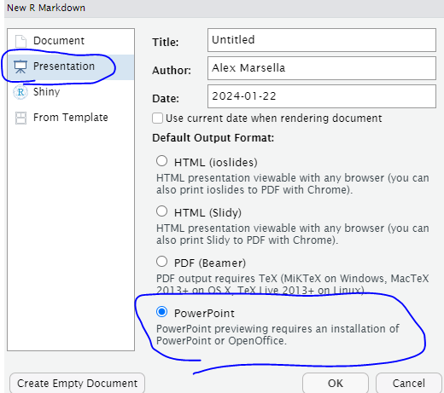
RMarkdown Slide show????
Yep.
You just do this when you open up a new RMarkdown document.

Slide 3
The plan for Today
Brief presentation on some tips and tricks for finding good data.
Usually I just give you data in this class, but you have your whole data analyst lives ahead of you.
Once we finish, I’ll cut you loose to work on anything in R you want, whether it’s HW1 (due Fri. 10am) or just you playing around with something you wanted to try out.
I am here to help if you need it, as always!

Slide 4
Finding Data
Be flexible, don’t expect to find exactly what you need in the format you need it in.
Be prepared to combine multiple datasets.
Be ready to clean and wrangle the data.
Some data comes “ready”; most complex questions require you to clean and wrangle data in a specific way
We will learn cleaning on Friday and wrangling on Monday.

Slide 5
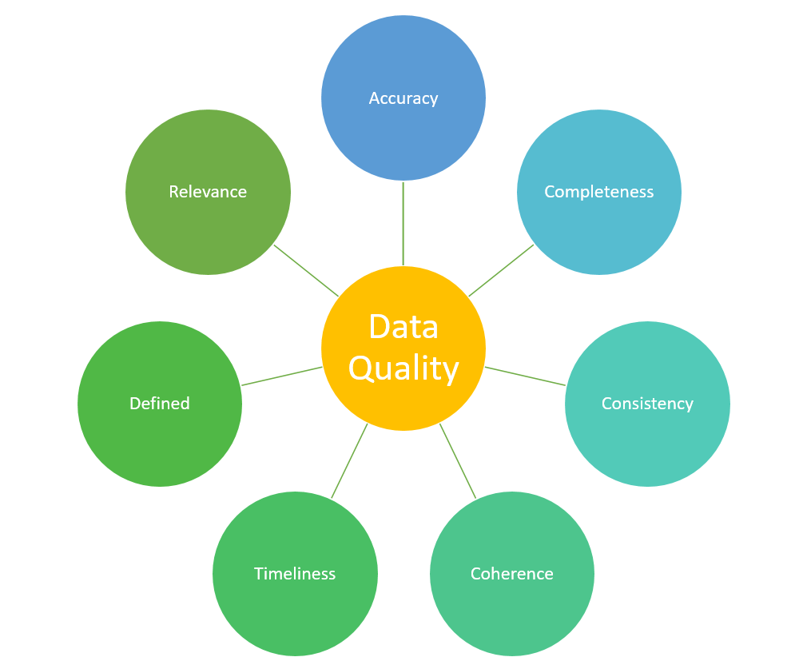
What Good Data Looks Like
Has good documentation explaining sources for variables and what variable names mean.
You need to be vigilant about making sure you know what your variables mean.
Every column has a heading, no headings are blank, no headings are duplicated.
Data type should be same within a column (variable)
R will always read data in this way, but data logged in Excel (as most data seems to be) can have mistakes like this.

Slide 6
“Good” is subjective. Good can be messy.
Reliable data may be in a messy format.
“Tidy” data is data that is in a format that is ready for analysis.
When I say “good”, I just mean data that is reliable, complete, and is or can (in reasonable time) be made tidy.
We will learn tidying techniques on Friday and Monday.

Slide 7
Good sources.
Economic Data –> fred.stlouisfed.org
Data about Americans and American households –> data.census.gov
Government Data –> Data.gov
Politics and Sports –> data.fivethirtyeight.com
Miscellaneous (anything) –> kaggle.com

Slide 8
Know what your variables mean!
Good data always comes with a “codebook” or “data dictionary”, explaining what every variable means.
#here I am going to read in some FRED data on "median usual weekly real earnings for full time employees ages 16 and up" earnings <- read.csv("earnings.csv")

Slide 9
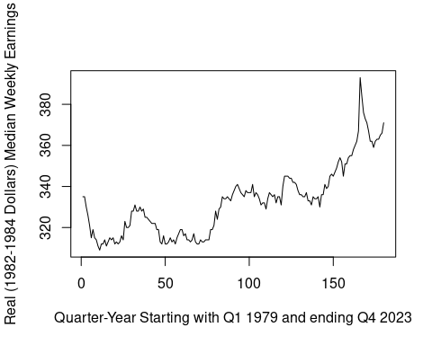
What do these variables mean?
Notice that Date is pretty self-explanatory, but then there’s this crazy variable that we don’t know the meaning of. Luckily, I know where the data comes from.
head(earnings) #gives us a peek at the data
## DATE LES1252881600Q ## 1 1979-01-01 335 ## 2 1979-04-01 335 ## 3 1979-07-01 330 ## 4 1979-10-01 326 ## 5 1980-01-01 321 ## 6 1980-04-01 315
plot(earnings$LES1252881600Q, type="l", xlab="Quarter-Year Starting with Q1 1979 and ending Q4 2023", ylab="Real (1982-1984 Dollars) Median Weekly Earnings")

Slide 10
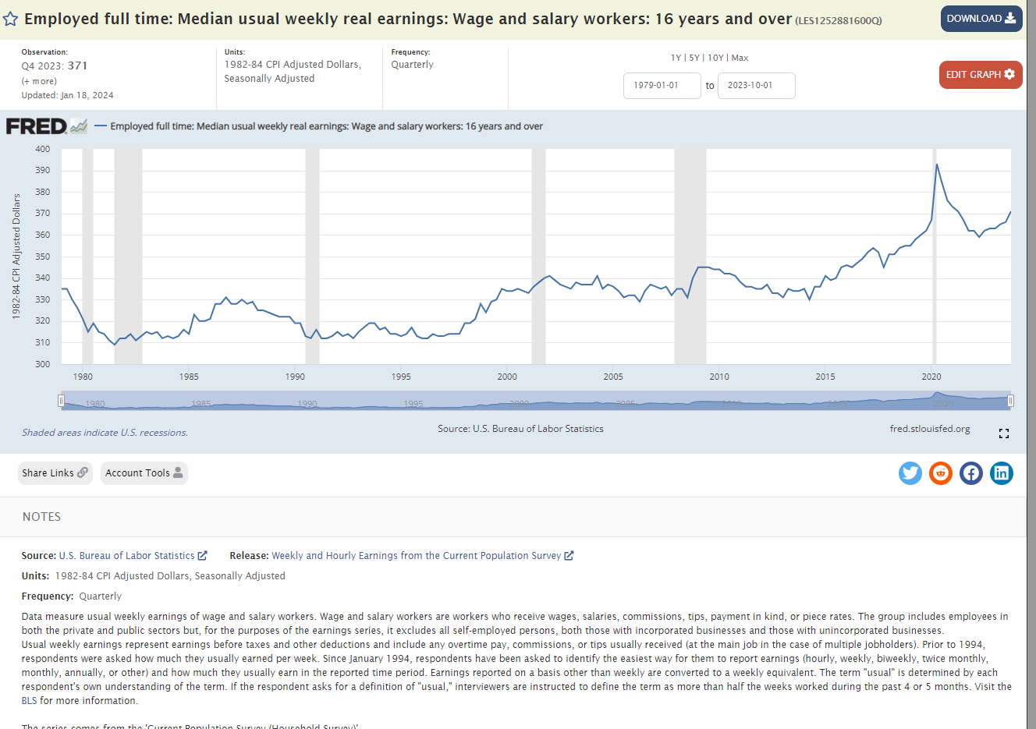
The page I got the data from.

Slide 11
Interpreting the line chart I made
Since I know what I’m measuring, I can see that median worker’s (the 50th percentile) real (inflation-adjusted) weekly earnings have grown over the past several decades.
Why is there spike a during Covid?
It’s because mostly lower wage workers were temporarily laid off, so the median earner was higher. In labor economics, we call that “compositional effect”, because the composition of the labor force briefly changed.

Slide 12
Formatting of dataset files
Stick to CSV. In excel? Save it as CSV. On Fred? Download as CSV.
You can then easily use read.csv("filename.csv")
As long as the file is in your working directory (with all those files in the bottom right of your R, you won’t need to type out a filepath.)

Slide 13

I wanted to use this image some how but I could not think of a good spot.
Me when I see data posted with no data dictionary.

Slide 14
Good data still sometimes requires a “good” bit of work
Visual (excel) appeal is often at odds with data useability (csv format)
Excel is very slow for big datasets, but looks good.
CSV is a faster format, but loses a lot of the visual appeal.
Datasets originally made in excel may have some strange features when loaded into R as .csv
You will learn how to deal with this.

Slide 15
The tidycensus package allows us to auto-load census data
The American Community Survey (ACS) is a common source of information about american households, collected by the census.
library(tidycensus) median_income <- get_acs(geography = "county", variables = "B06011_001", state="georgia", year=2020, geometry=TRUE) # I happen to know that "B01002_001" is median age. I set geometry=TRUE so I can map it. # As long as you know your variable CODE, you can pull it!

Slide 16
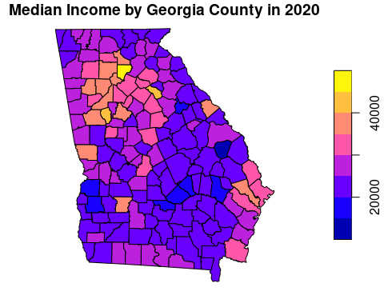
Tidycensus allows me to automatically pull the map coordinates of census data!
plot(median_income["estimate"], main="Median Income by Georgia County in 2020")

Slide 17
The data dictionary for the ACS is available in tidycensus as well!
vars <- load_variables(year = 2020, dataset = "acs5") names(vars)
## [1] "name" "label" "concept" "geography"
# It's too big to show in powerpoint, but you can look at it in R.

